Slide 1

Webdriver.IO
Next-gen browser and mobile automation test framework for Node.js
Testing Mavens
12-21-2022
Presented by: Anil Ca

Slide 2


Index
Overview of WebdriverIO.
Advantages of WebdriverIO.
Why WebdriverIO.
Jasmine Framework.
Allure Reporter
WebdriverIO v/s Cypress.
Applications supported.
Companies using WebdriverIO.

Slide 3


Overview of WebdriverIO
Build on top of Node.js
Open-source tool.
Used for Web application testing.
Uses WebDriver protocol.
Works on multiple browsers and operating systems.
1

Slide 4

Advantages of WebdriverIO
Easy Setup
Cross-Platform
Browser Support
Automation Features
Support cloud services.
Powerful and easy-to-use API.
Full access to native webdriver protocol.
Fast and reliable due to data-driven architecture.

Slide 5
Why WebdriverIO?
WebdriverIO is a progressive automation framework built to automate modern web and mobile applications.
It is designed to be:
Extendable - Easy to add helper functions, or more complicated sets and combinations of existing commands.
Compatible - WebdriverIO can be run on the WebDriver Protocol for true cross-browser testing as well as Chrome DevTools Protocol for Chromium-based automation using Puppeteer.
Feature Rich - The huge variety of built-in and community plugins allows you to easily integrate and extend your setup to fulfil your requirements.

Slide 6
Jasmine Framework.
The Jasmine framework allows it to intercept each assertion in order to log the state of the application or website, depending on the result.
It provides a better structure for testing JavaScript code.
Jasmine Options
defaultTimeoutInterval
helpers
requires
random
seed
failSpecWithNoExpectations
oneFailurePerSpec
specFilter
grep
invertGrep

Slide 7
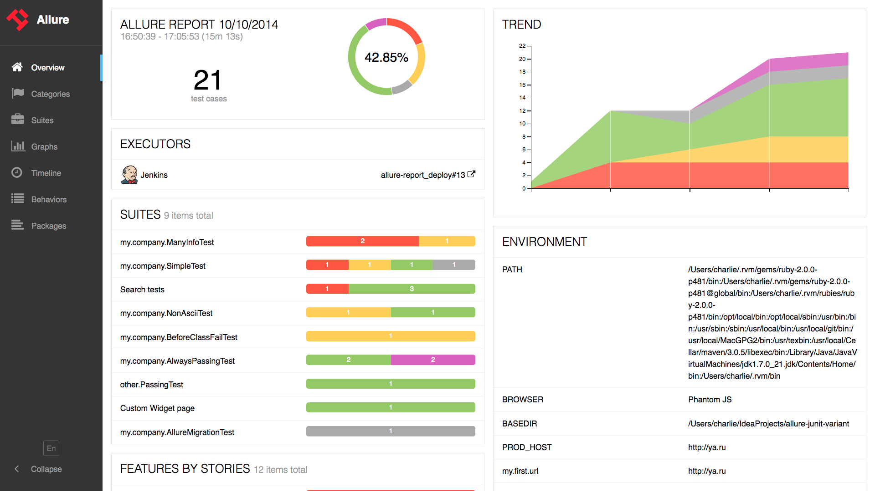
Allure Report
Allure report generates detailed, interactive, and easy-to-understand reports on test results.
Features of Allure Report
Clean and Concise Reporting
Flexible Reporting
Easy Integration
Detailed Reporting
Cross-Platform Support

Slide 8
Applications supported.
🌐 modern web applications written in React, Vue, Angular, Svelte or other frontend frameworks 📱 hybrid or native mobile applications running in an emulator/simulator or on a real device 💻 native desktop applications (e.g. written with Electron.js) 📦 unit or component testing of web components in the browser

Slide 9
WebdriverIO v/s Cypress
WebdriverIO | Cypress
WDIO supports multiple-origin website navigation. WDIO supports multiple tabs and windows. WDIO comes with X-Path, CSS selector etc. WDIO supports all major browsers. WDIO supports mobile testing using Appium. | Cypress does not support multiple-origin website navigations. Cypress does not support multiple tabs and windows. Cypress does not come with x-path locator support. Cypress supports only the chromium family and Firefox. Cypress does not have support for mobile testing.

Slide 10
Companies using WebdriverIO
eBay
Microsoft
Apple
Google
Amazon
Twitter
LinkedIn
PayPal
Uber
Yahoo

Slide 11
Thank you!

